Slide 1
Car wash app
Reserving appointments and requesting car wash service

Slide 2
Problem statement
01
Aim
02
Technology
Objectives
TABLE OF CONTENTS
04
03
Similar Application
05
Diagram
06

Slide 3
01
Problem statement
Car wash app

Slide 4

Problem Statement
The crowding and the time wasting at car wash line

Slide 5
02
Aim
Car wash app

Slide 6
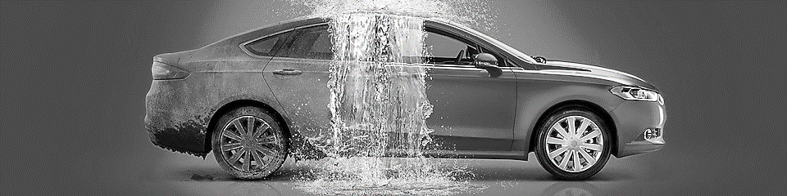
Aim
Saving time
Comfortable
Request car washing service
Appropriate time and place
Notes:
An application that will allow the user to request service, to book the car washing service at a certain time of the day (along with other washing options).

Slide 7
03
Objectives
Car wash app
Notes:
The main objective of the car wash system is making car wash service full automated form the costumer reservation to paying and reviewing the service

Slide 8

Objective
Comfortable
Fast
Secure
The ability of the customer to book the most appropriate time and date
Browse and reviewing the evaluation of customers in terms of services provided and offers
Satisfaction
Provide home car cleaning service
Provide several payment methods for user

Slide 9
04
Technology
Car wash app
Notes:
We will use a flutter framework to program our application to ensure access to the largest segment of customers, and the control panel will be built using Laravel framework.

Slide 10
Technology
Flutter
CAR Wash Application
Laravel
MySQL database
Notes:
1- flutter is a cross platform software development kit which allows developer to
2-
3-

Slide 11
05
Similar Application
Car wash app

Slide 12


Similar Application
Ghaseel app:
Sayar app:

Slide 13
06
Diagram
Car wash app

Slide 14
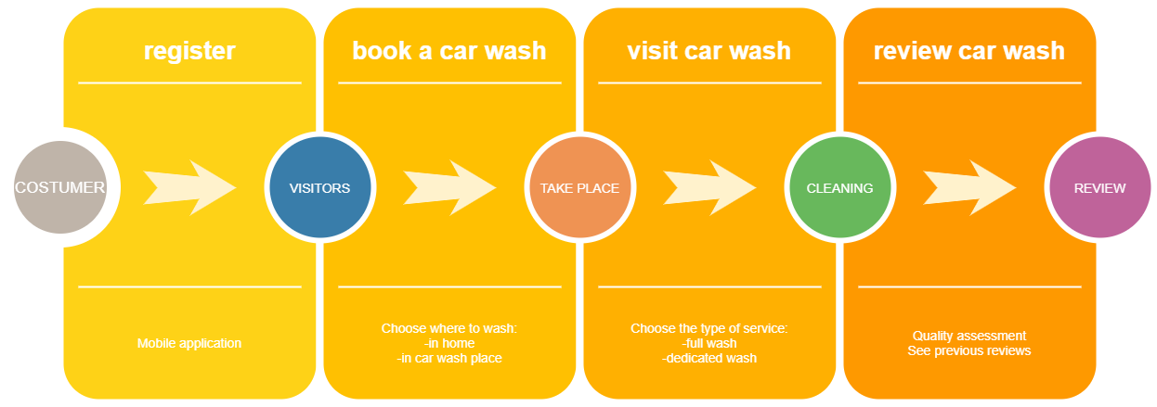
Framework

Slide 15
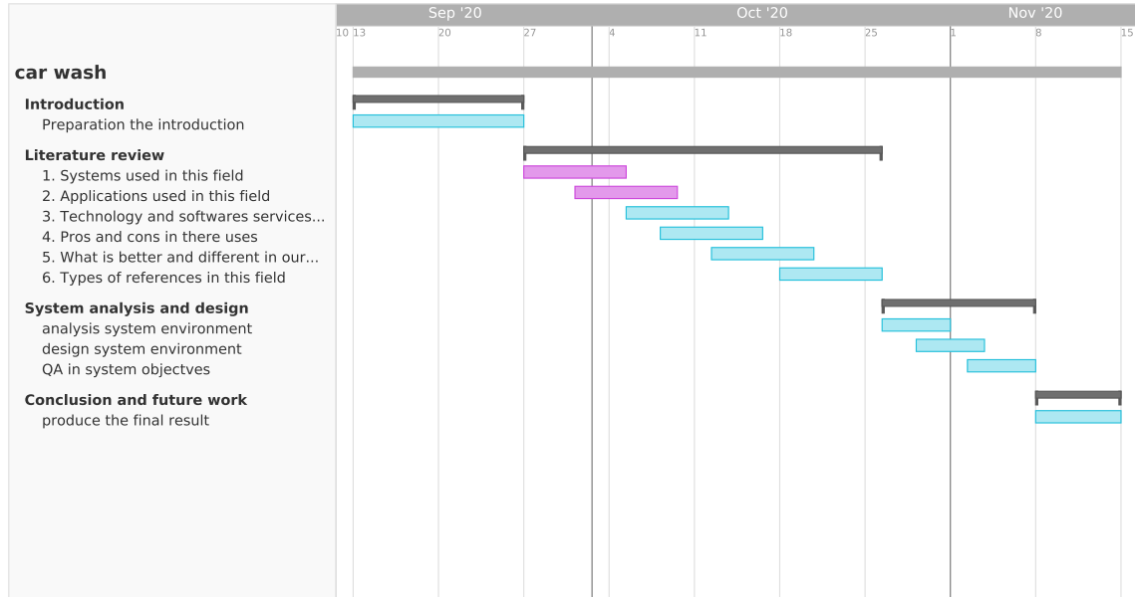
Gantt chart

Slide 16
Introduced by
Anas Ahmed Bawazir
Reslaan Razoq
Mohammed Gamal
Computer science Student
362049763
Computer science
Student
362051303
Computer science Student
362049583
Supervised by:
Dr-Yazed Alsaawy

Slide 17
THANKS
Does anyone have any questions?

